Slide 1


Predictive Modeling and Analysis of Housing Prices: A Comprehensive Approach Using Regression and Classification Techniques
Group-3
Vinay Kacharam
Raju Rishikesh Gollapally
Devambatla Sai Sharanya

Slide 2



Accurate House Price Forecasting
Accurate house price forecasts are crucial for strategic decision-making in the ever-changing real estate market. The complex relationships between different home elements and property values are set to be unravelled by this project's extensive analysis, which employs advanced modelling approaches. Predictions that accurately guide stakeholders in strategic investments and transactions are becoming more and more vital as the housing industry undergoes ongoing evolution.

Slide 3
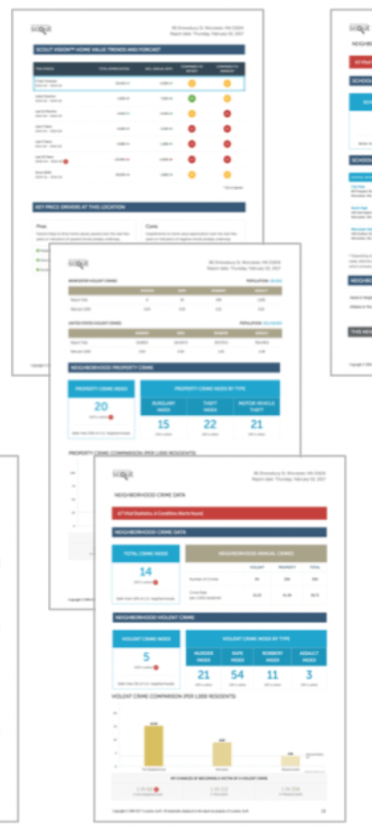
Data Source
Dataset: House_Prices.csv
Supplementary Dataset: BA-Predict.xlsx
The thorough dataset covers critical elements like lot area, general quality, year built, and other essential information, providing a sturdy platform for deciphering the nuances of the real estate sector.
Acts as a validation set for assessing the predictive capabilities of the developed models on new, unseen data, providing a solid basis for in-depth analysis.

Slide 4
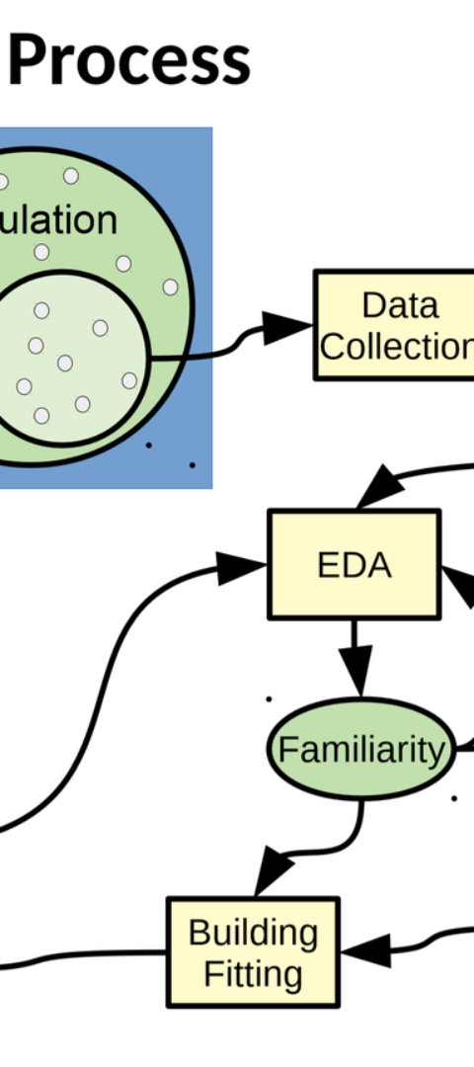

Data Exploration Analysis
Complete Investigation
The intrinsic properties and intricate interactions among variables are thoroughly investigated to establish the groundwork for informed decision-making in following modeling initiatives.

Slide 5
Modelling Strategy: Regression Model
Feature Selection
Model Development
Hyperparameter Tuning
A thorough procedure of feature curation is done to detect the crucial variables influencing house prices.
Leveraging modern statistical approaches, the model is created with precision to serve as a robust foundation for projecting house prices.
A detailed hyperparameter tuning process ensures optimal performance of the linear regression model in real estate assessment.

Slide 6
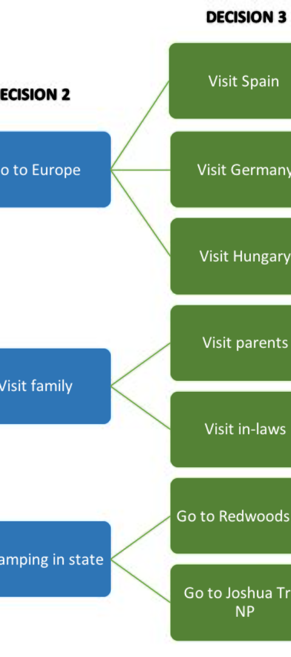
Modelling Strategy: Decision Tree Model
1
Feature Selection
A discriminating procedure to precisely choose critical characteristics crucial for capturing non-linear interactions.
2
Model Development
The model's creation incorporates an expert synthesis of data-driven ideas, ensuring its aptitude in identifying subtle patterns that transcend beyond linear connections.
3
Hyperparameter Tuning
Optimizing the decision tree model comprises a thorough fine-tuning approach targeting crucial hyperparameters such as tree depth and splitting criteria.

Slide 7

Modelling Strategy: Classification Model
1
Feature Selection
2
Model Development
3
Hyperparameter Tuning
A keen emphasis is made on feature selection to predict high-quality dwellings (OverallQual >= 7).
The model's creation incorporates a mix of statistical approaches and domain experience, ensuring a solid framework for precise classification.
Hyperparameter adjustment has paramount relevance in boosting the discriminative prowess of the logistic regression model.

Slide 8
Model Performance Estimation
Regression Model
Model Establishment (based on 'train' dataset)
Regression Model
Prediction Performance (based on 'test' dataset)
Decision Tree Model
Model Establishment (using the 'train' dataset)
Classification Model
Model Establishment (using the 'train' dataset) of the Classification Model
Classification Model
Forecasting Performance (based on 'test' dataset)

Slide 9

Insights and Conclusions: Key Findings
1
Regression Model
2
Decision Tree Model
Displays a respectable accuracy in predicting property values, utilising specified factors.
Adeptly incorporates non-linear correlations, raising the precision of forecasts.
3
Classification Model
Excels in categorizing residences based on quality, delivering significant insights for prospective purchasers.

Slide 10
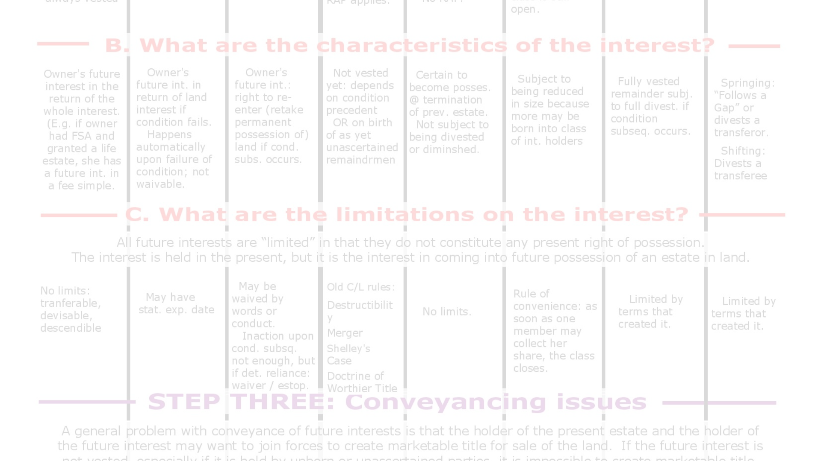
Limitations and Future Work
Dataset Size Limit
Future Initiatives
External Factors
Provides issues for robust model generalization to fresh data.
Should encompass the inclusion of other features, improving the analysis's comprehensiveness.
Mainly economic situations can influence house prices and demand additional research.

Slide 11

Recommendations
1
Regression Model
2
Decision Tree Model
3
Classification Model
For exact housing price projections, leveraging its known accuracy.
To untangle complex linkages within the dataset.
For successful categorization of residences based on quality, offering helpful recommendations for potential purchasers.

